Slide 1
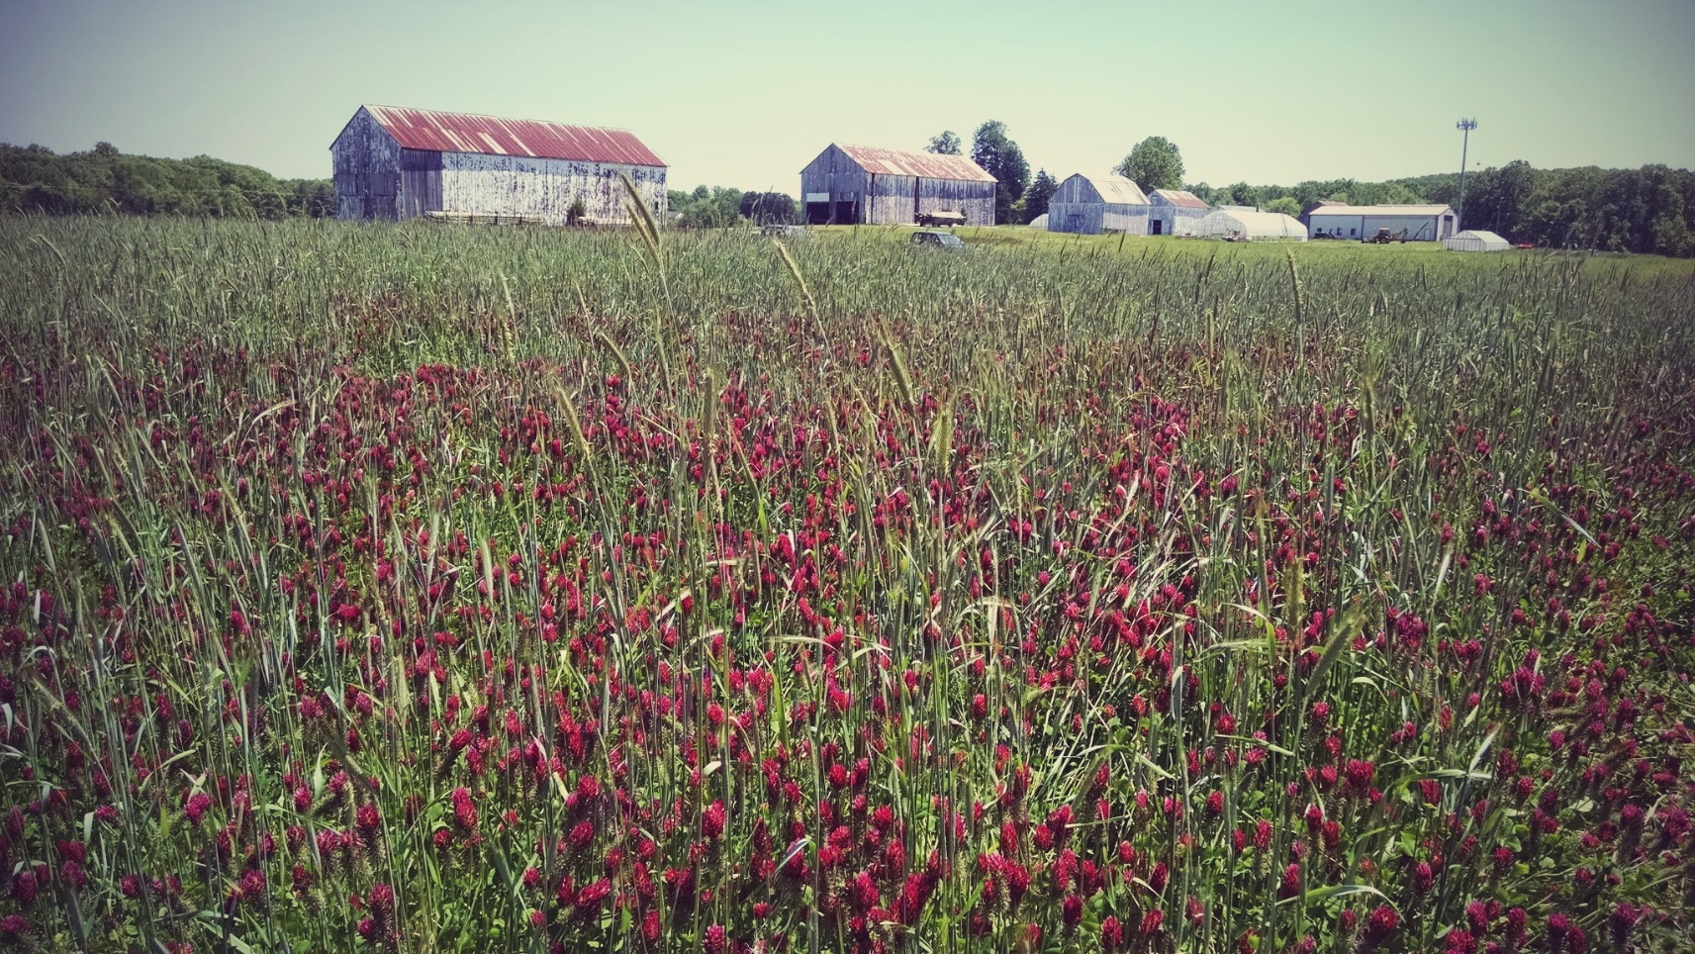

Cover Crop Diversity and Management for Weed Control in Organic Agro-Ecosystems
Amanda L. Buchanan^{1,2}
Guihua Chen¹
Cerruti R.R. Hooks¹
¹University of Maryland
²Michigan State University
OK!

Slide 2
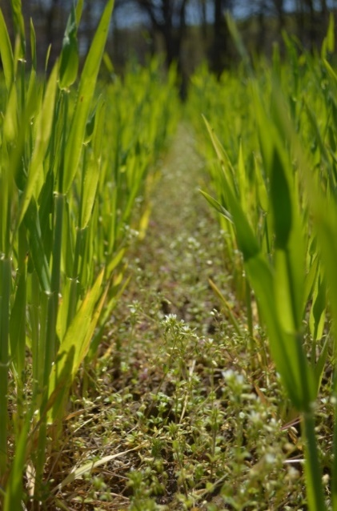
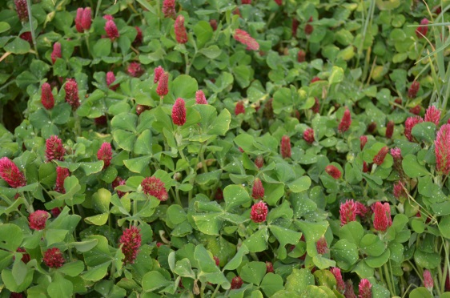
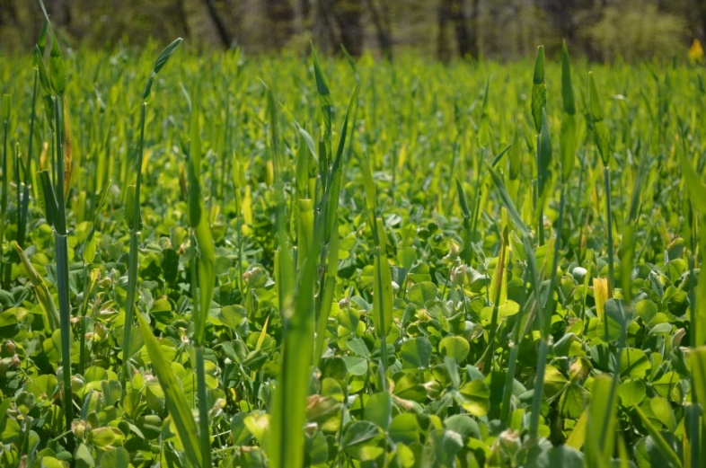
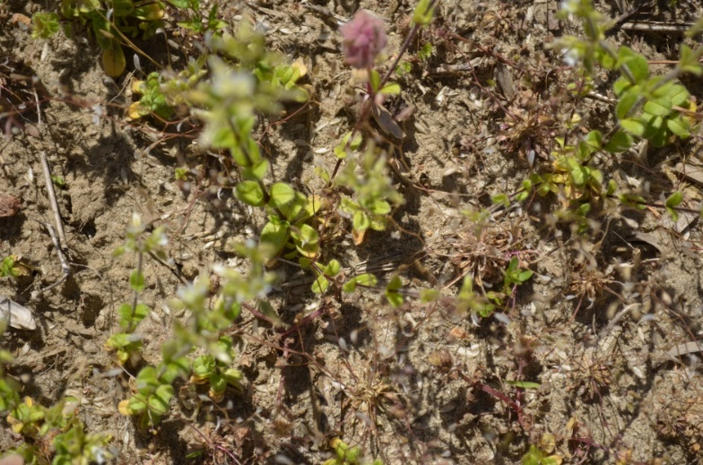
Cover crops: single species/mixed species
Barley
Crimson clover
Strong competitor
Allelopathic
Nitrogen fixation
Ground cover
Naturally occurring weeds (control)
Barley plus crimson clover
Biomass accumulation
Optimal C:N

Slide 3
Cover crops: single species/mixed species
Cover crops influenced pre-mowing weed biomass
a
b
c
c

Slide 4
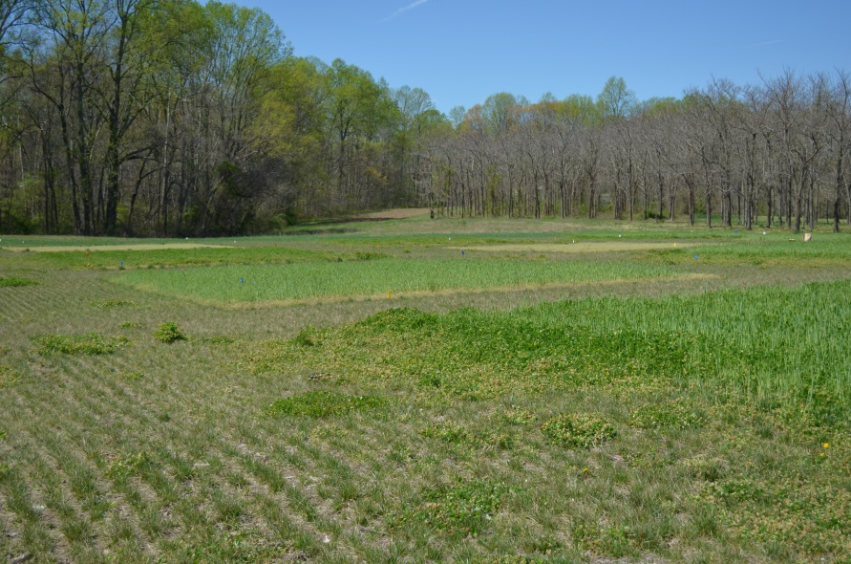
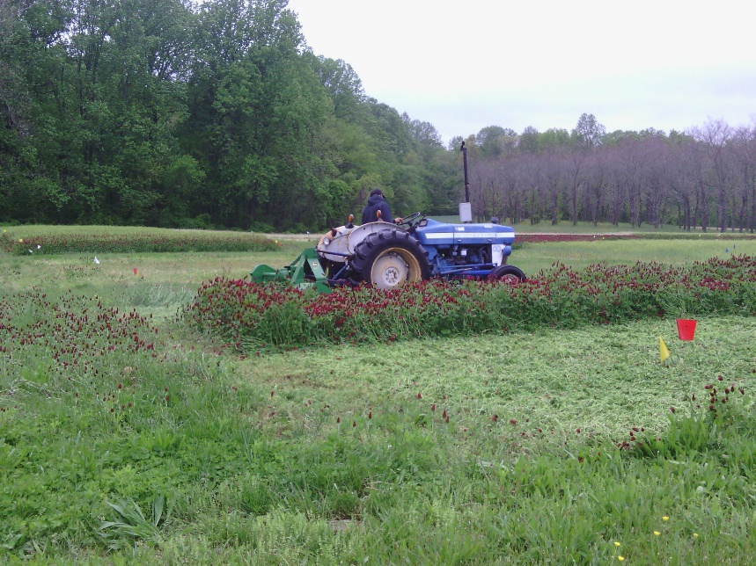
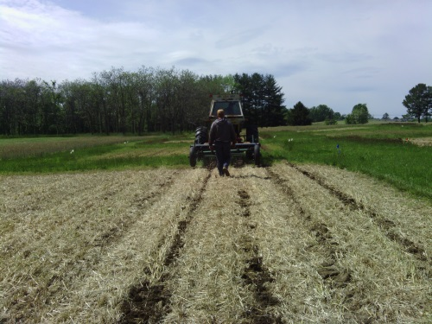
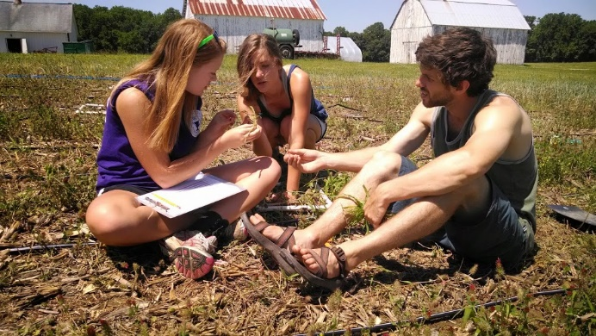
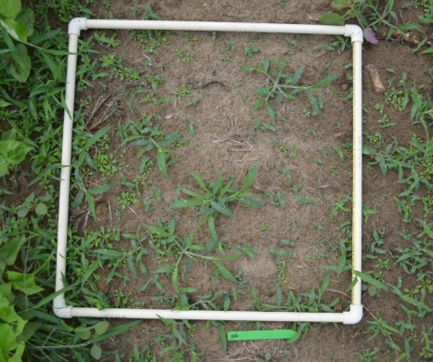
Cover crops: single species/mixed species
Spring growth
Flail mow
Strip till
Weed density
Species identification

Slide 5
Cover crops: single species/mixed species
Cover crops influenced in-field weed species composition and diversity
Hꞌ ~ 2.1
Hꞌ = 1.17
ANOSIM R = 0.41
P = 0.001

Slide 6
Cover crops: single species/mixed species
Cover crops reduced in-field weed density
a
b
b
b

Slide 7
Cover crops: single species/mixed species
Barley reduced main crop yield
a
a
ab
b

Slide 8
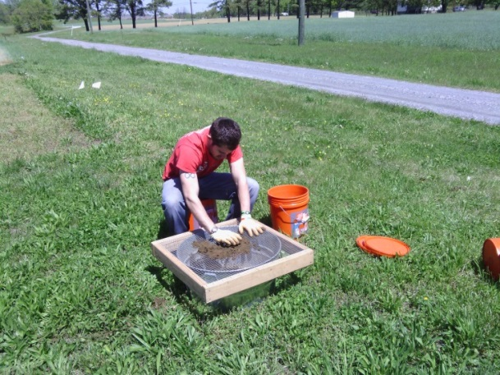
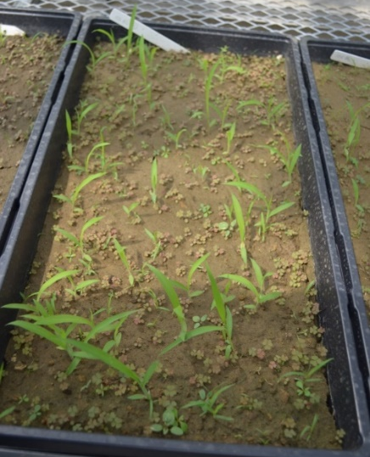
Cover crops: single species/mixed species
Weed seedbank sampling
Weed seed species identification and density

Slide 9
Cover crops: single species/mixed species
Only year influenced seedbank species composition
2014
2013
2012
2011
Treatment R = -0.04, P = 0.97
Year R = 0.77, P = 0.001

Slide 10
Cover crops: single species/mixed species
Only year influenced seedbank species composition
Cover crops did not influence seedbank density
F_{3,10} = 0.12
P = 0.95
2014
2013
2012
2011
Treatment R = -0.04, P = 0.97
Year R = 0.77, P = 0.001

Slide 11
Cover crop Weeds Weed seeds
Presence (cover crop vs fallow)

Slide 12
Cover crop Weeds Weed seeds
Presence (cover crop vs fallow)
Identity (barley vs crimson clover)

Slide 13
Cover crop Weeds Weed seeds
Presence (cover crop vs fallow)
Identity (barley vs crimson clover)
Mixture (single vs mixed species)
*

Slide 14
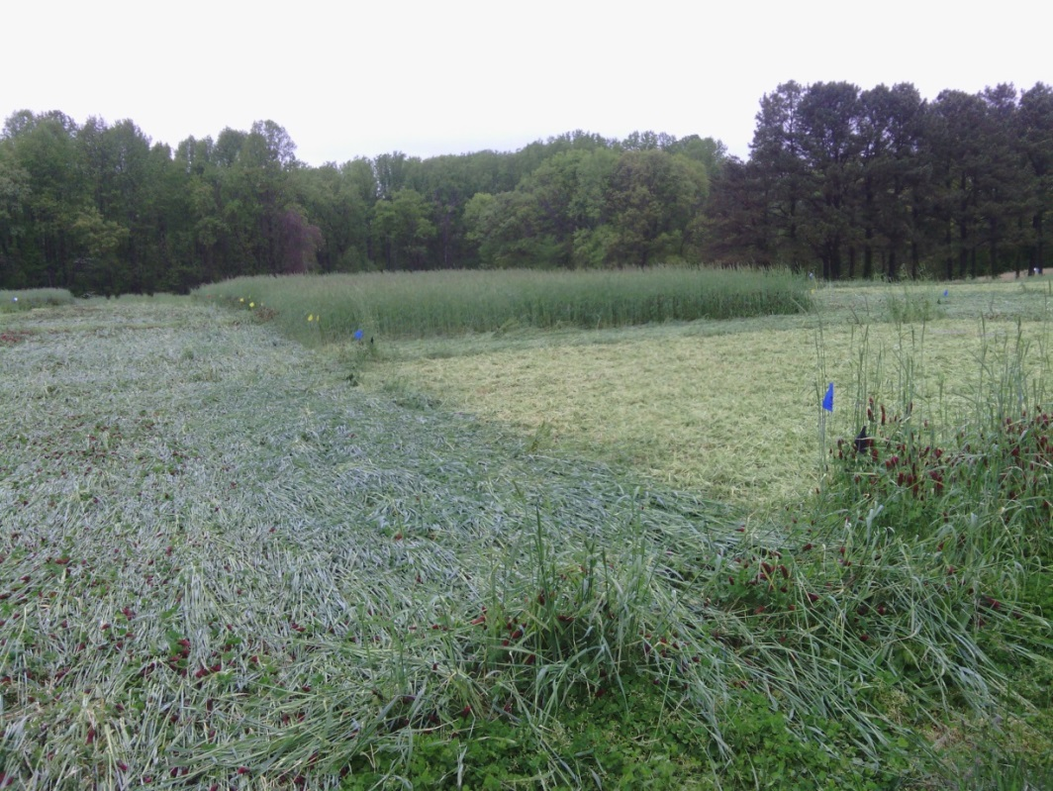
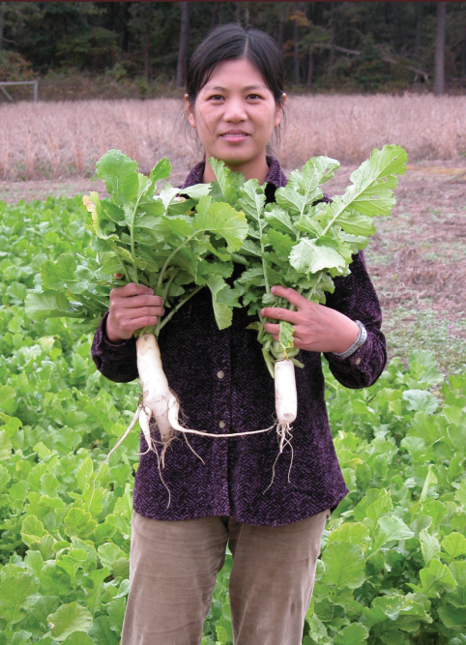
Cover crops: management

Slide 15
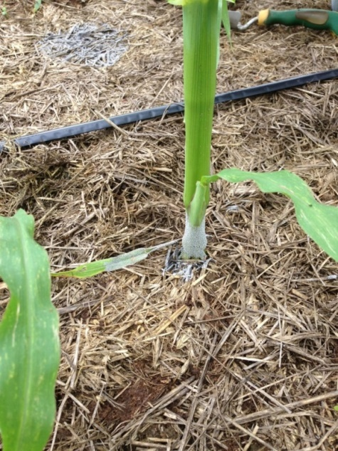
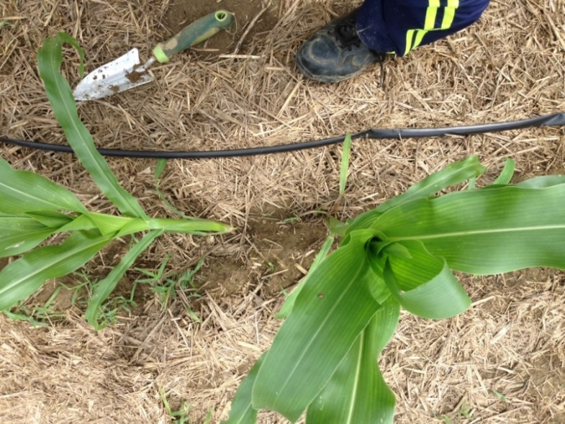
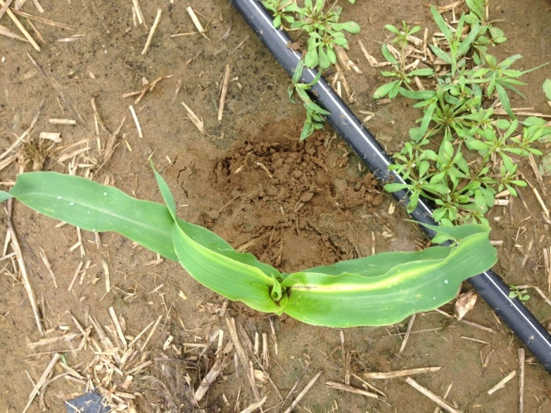
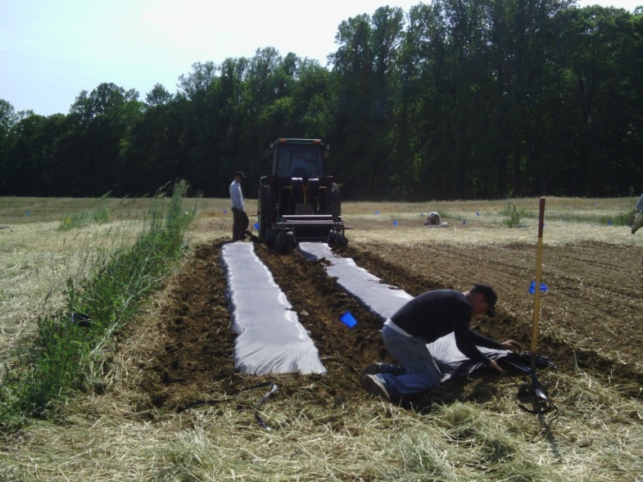
Cover crops: management
Strip till
No till
Little disturbance
Intermediate surface cover
No disturbance
High surface cover
Black plastic
Conventional till
High disturbance
Intermediate surface cover
High disturbance
No surface cover

Slide 16
Cover crops: management
Weed seedbank sampling
Weed seed species identification and density
Weed density

Slide 17
Cover crops: management
Management influenced in-field weed density
a
b
b
c

Slide 18
Cover crops: management
Only year influenced seedbank species composition
2014
2013
2012
Treatment R = 0.004, P = 0.37
Year R = 0.48, P = 0.001

Slide 19
Cover crops: management
Only year influenced seedbank species composition
Management influenced seedbank seed density (final year)
a
a
ab
2014
b
2013
2012
Treatment R = 0.004, P = 0.37
Year R = 0.48, P = 0.001

Slide 20
Cover crop Weeds Weed seeds
Presence (cover crop vs fallow)
Identity (barley vs crimson clover)
Mixture (single vs mixed species)
Management
*
Mixed cover crop provided all-around benefits
Integration of disturbance and residue

Slide 21
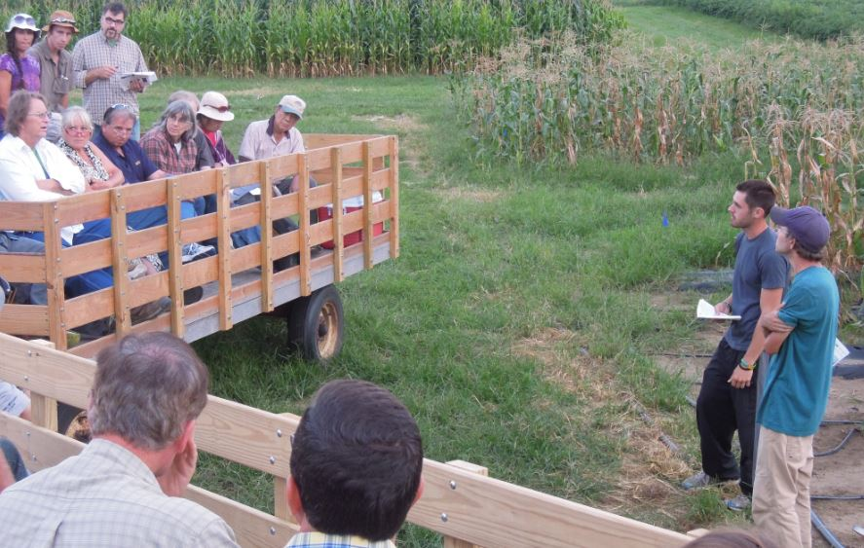
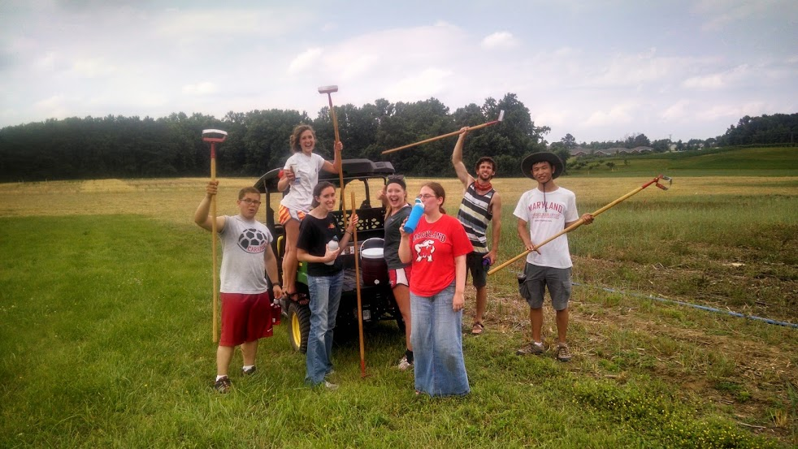


Thanks to:
The Central Maryland Research and Education Center, especially Alfred Hawkins, Tim Sheils, Ron, Bill, and Casey
The Hooks lab, especially Peter Coffey, Lauren Hunt, and Lauren Kolb
Our hard-working field crews: Hannah Weiss, Greg Polley, Peter Lynagh, Gil Hasty, Katie Judd, Beth Hellman, Chana Franz, Mark Dudley, and Anthony Zhao
Our funding:
USDA-NIFA OREI
USDA-NIFA ORG
Contact:
@a_mandy_lynn
alynnbuchanan@gmail

